Slide 1
Venice Community Plan and Local Coastal Program Update
OCEAN FRONT WALK &
ABBOT KINNEY BOULEVARD
PUBLIC MEETING – MARCH 11, 2024
Community Plan and Local Coastal Program Ad Hoc Committee
of the Venice Neighborhood Council

Slide 2
The purpose of this meeting is to obtain your opinions.
We record and transcribe each speaker comments, so we ask you to use the microphone up front.
Please fill out the Preference Survey during this meeting and turn it in before leaving – if you have not yet filled out the on-line survey or the same paper survey before. Thanks.

Slide 3
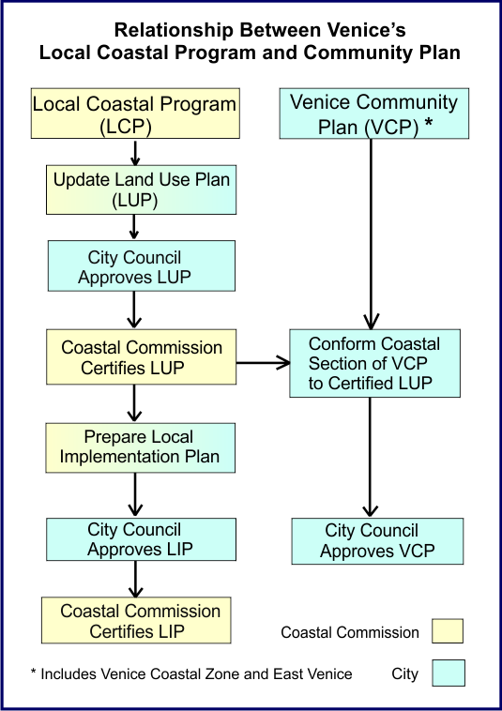
Steps in Updating The Plans:
City Planning has already started updating the 2004 Venice Community Plan, releasing a draft this past August.
The update of the Venice Land Use Plan is also underway.
City Planning also has been working with an Advisory Group on all four Westside Los Angeles community plans.

Slide 4
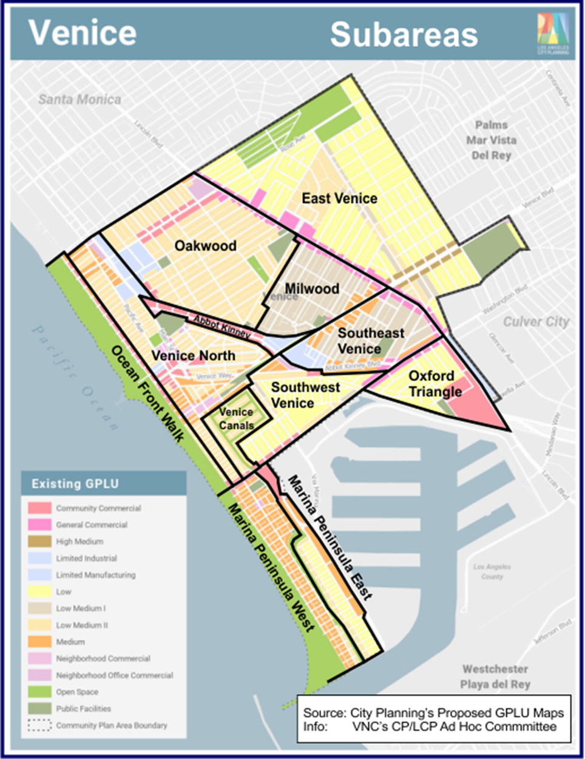
Steps in This Process
Two introductory meetings explaining process, schedule, and Survey.
Seven weekly neighborhood-by-neighborhood public meetings for public input. (thru March 11th)
Sharing of Findings. (early April)
Draft Results Report for Public Review & VNC approval. (April - May)

Slide 5
Venice is a Special Coastal Resource
Venice is one of 13 “man-made coastal resources” noted in 1975 Coastal Plan.
1976 Coastal Act requires coastal resources to be accessible and protected for all citizens of California.
Venice’s land use plans should reflect this obligation.
L.A. Chamber ranks Venice as #2 SoCal tourist destination after Disneyland.

Slide 6
Density Bonus Projects
Density Bonus is a state-wide program encouraging developers to build more affordable housing by offering incentives in exchange. These incentives might include:
Increased density: Building more units on the same land than existing zoning allows.
Reduced parking requirements: Saving costs and land for other uses.
On- and Off-Menu incentives or Waivers: Greater FAR, increased height, side yard variances, etc. in order to provide for the additional affordable units.
Minimum Affordable units depend on the type of project and chosen incentives, but generally at least 5% of units for very-low-income households, or 10% for lower or moderate-income.
The minimum number of TOTAL units for an affordable housing density bonus project in California is at least five (5) dwelling units.

Slide 7
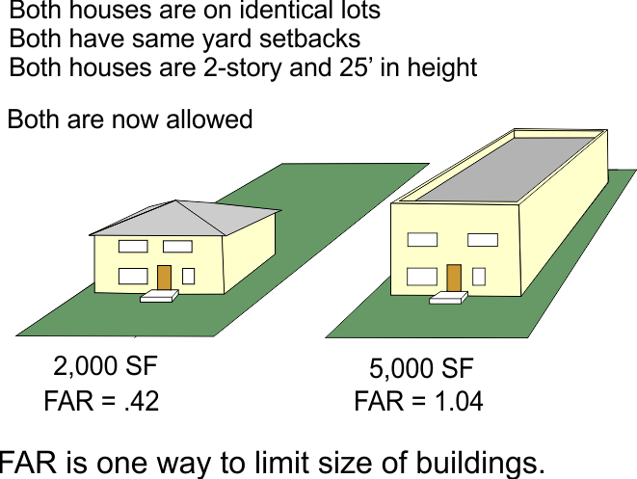
What is Floor Area Ratio and Why Is It Important?

Slide 8
Ocean Front Walk

Slide 9
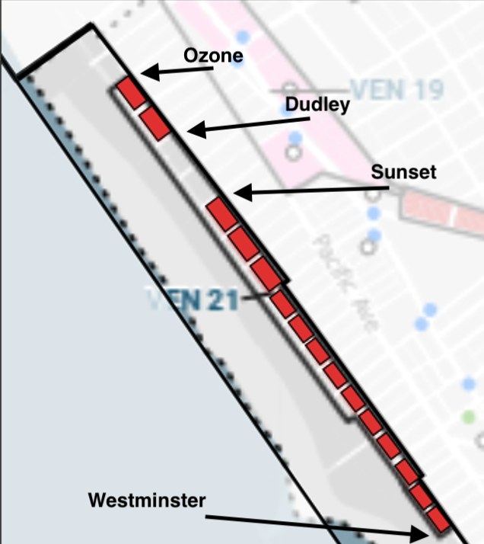
City Planning Proposed Commercial Zoning Changes
Hub of regional commerce, usually
along major transportation corridors. Mid rise to high rise, active shopfronts and active streets. Provide a significant number of jobs, in addition to residential, retail, government, entertainment, cultural facilities, and health facilities.
 | Existing | Proposed |  | Proposed w/bonus
VEN 21 (Ocean Front Walk, Westminster to Ozone)
Height | 30' flat or 35' sloped roof | 3 stories | 3 stories | 5 stories | 5 stories
FAR | 0.5 to 1.5 depending on use | 1.5 | 1.5 | 3.0 | 3.0
Base Density | 1 unit /800 SF if mixed-use | 1 unit/800 SF if mixed use | 1 unit/800 SF if mixed use
Lot consolidation | more than 2 if scale & character

Slide 10
Abbot Kinney Boulevard

Slide 11
City Planning’s Proposed Commercial Zoning Changes
Walkable block patterns, serve
as historic/cultural regional niche market destinations.
Restaurants, retail, services, small offices interspersed
with a range of housing types. Comm’l on ground floor.
 | Existing | Proposed | Proposed w/bonus
VEN 20 (Abbot Kinney Blvd. north of Venice Blvd.)
Height | 30' flat or 35' sloped roof | 3 stories | 5 stories
FAR | 0.5 to 1.5 depending on use | 1.5 | 3
Base Density | 1 unit/800-1,200 SF if mixed-use | 1 unit/800 SF if mixed use
Lot Consolidation | more than 2 if scale & character | ?
Westminster
School
Palms Ave

Slide 12
City Planning’s Proposed Hybrid Industrial Zoning Changes
Preserve productive activity, prioritize employment
uses, accommodate live work uses or limited
Residential uses. Uses include light industrial,
Commercial, office, with selective live/work uses.
 | Existing | Proposed | Proposed w/bonus
VEN 31 (blue), VEN 30 (purple)
Height | 25' flat or 30' sloped roof | 3 stories | 5
FAR | None | 1.5 | 3
Base Density | Not Allowed | VEN 31: Not Allowed VEN-30: 1 unit/800 SF
Lot Consolidation | 2 lots | ?
* 30' flat roof, 35' sloped roof north of Venice Blvd.

Slide 13
End

